Slide 1
Sprint 4
Chris Kenny and Aaron Guensch

Slide 2
Meet the Team!
Chris Kenny: Leader/Developer
Responsibilities included ensuring smooth operations, develop code, and complete work
Aaron Guensch: Co-leader/Developer
Responsibilities included developing code and completing work

Slide 3

What did we learn about software engineering?
Programming fundamentals (Loops, conditions, functions, etc.)
Algorithmic thinking (Breaking down the problem into steps)
Troubleshooting
Testing and Quality Assurance

Slide 4

Challenges we faced:
Losing a team member as the first sprint was assigned
Issues with achieving the same results as tests were conducted
Uploading documents and videos to Github
Formatting issues (Sprint 1 only)
Building connectivity issues

Slide 5
So what could we do differently?
When coding our robots, having a strictly fixed point indicating where to start the robot for each test
Uploaded documents to github as completed rather than all at once
Scheduled to meet in-person to work on more parts of the project

Slide 6
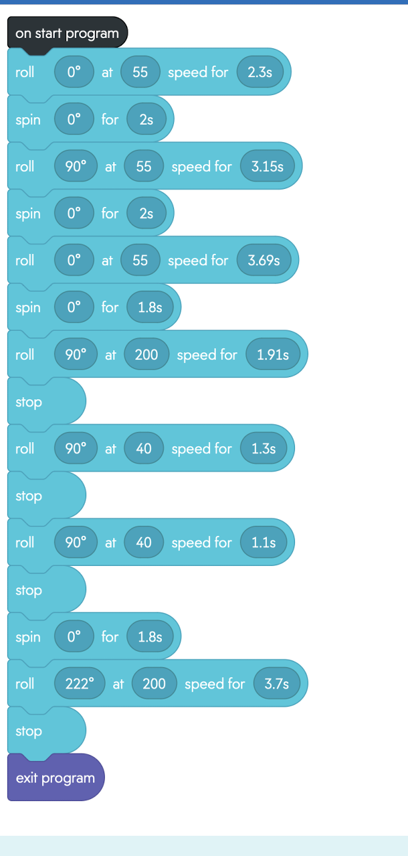
Sprint 3 (Agility) Code:

Slide 7

Sprint 3 Video:

